Slide 1


Unit 2
HHFA data analysis platform outputs
Notes:
Welcome to Unit 2 of Module 2.
In this unit, we will look at the outputs of the HHFA data analysis platform.

Slide 2
By the end of this unit, you will:
list the four standard HHFA data analysis platform outputs
list four types of HHFA stratifier variables
summarize the uses of tables, graphs, and maps for visualizing HHFA data
Notes:
By the end of this unit, you will:
list the four standard HHFA data analysis platform outputs;
list four types of HHFA stratifier variables; and
summarize the uses of tables, graphs, and maps for visualizing HHFA data.

Slide 3


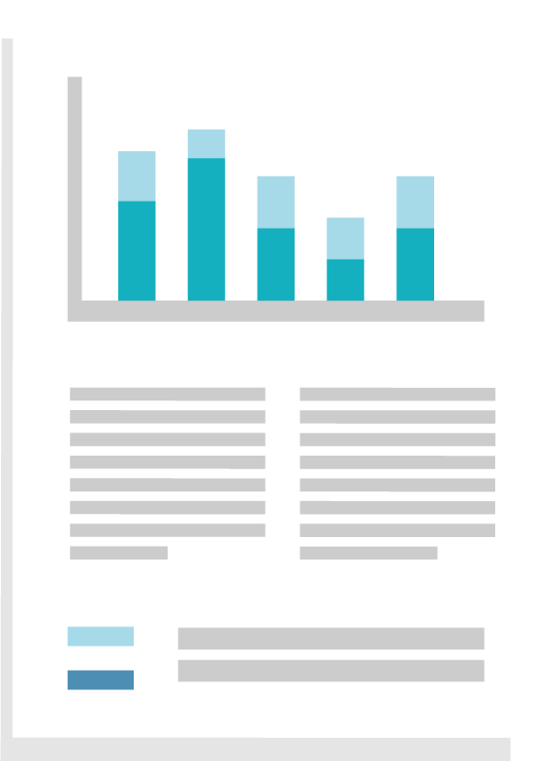
HHFA data analysis platform outputs
data analysis platform
calculates the HHFA indicators
standard analysis outputs
no specialized software/expertise required
tables
graphs
maps
report outline
Notes:
The analysis platform automatically calculates the HHFA indicators, and displays them in standard tables and graphs, and sometimes also in maps.
The platform also provides these outputs in a standard report outline that can serve as a framework for the country HHFA report.
This automation means that you don’t need any specialized statistical software or expertise to conduct the analysis.

Slide 4
HHFA analysis plan
Every survey should have an analysis plan.
The analysis plan defines:
standard analysis outputs
the survey indicators
how they will be presented
The standard outputs of the HHFA analysis platform represent the basic, standard HHFA analysis plan, based on the standard HHFA indicators.
Notes:
Every survey should have an analysis plan.
The analysis plan defines the survey indicators and how they will be presented.
It serves as a roadmap that guides the data analysis process.
The standard outputs of the HHFA analysis platform represent the basic, standard HHFA analysis plan, based on the standard HHFA indicators.

Slide 5
HHFA analysis plan
Additional
country-specific analyses
standard analysis outputs
indicators needed
tables / graphs needed
HHFA standard analysis plan
Country-specific additional analysis plan
Notes:
To complement the standard HHFA analysis plan, a country may also want to conduct additional analyses based on further questions that they want to answer.
A plan for the additional analyses should then be developed, defining the indicators needed and the way in which they will be grouped in tables or displayed in graphs.

Slide 6

Producing the analysis platform outputs
It is important to start the HHFA analysis and review process by running a complete analysis of ALL the survey data, generating the full range of standard analysis platform outputs.
Notes:
It is important to start the HHFA analysis and review process by running a complete analysis of ALL the survey data, generating the full range of standard analysis platform outputs.

Slide 7
HHFA data analysis platform outputs
The analysis platform provides descriptive analyses:
distribution of indicator frequencies (percentages)
comparisons among subgroups of facilities (stratifier variables)
Notes:
Many different types of analyses can be obtained from surveys.
The analysis platform provides descriptive analyses based on the:
distribution of indicator frequencies (or percentages); and
on comparisons among subgroups of facilities.
A specific type of facility subgrouping is called a “stratifier variable”.

Slide 8




HHFA stratifier variables
facility type
managing authority
urban or rural location
geographic area
Notes:
Stratifier variables commonly used in the HHFA include:
facility type (e.g. hospital, health centre, and health post)
managing authority (e.g. public and private)
urban or rural location, and
geographic or administrative area (e.g. regions or districts).

Slide 9
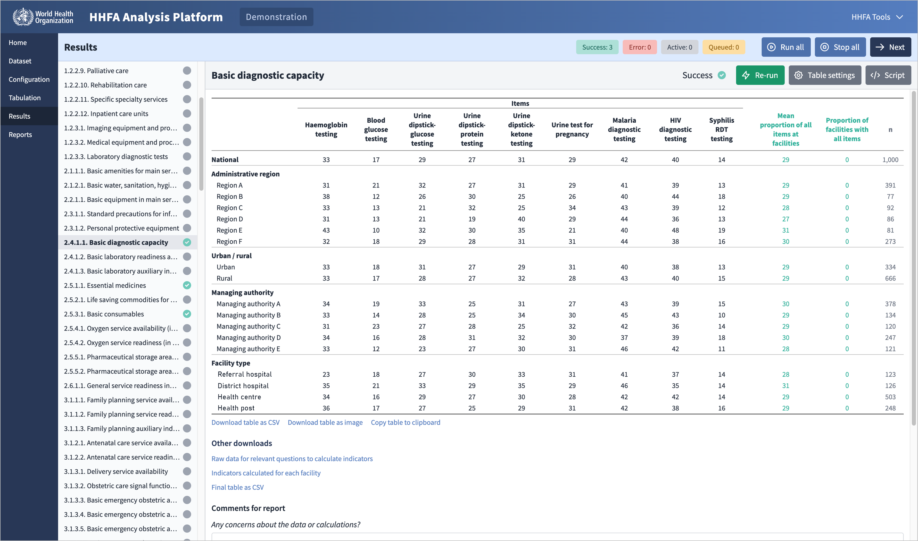
HHFA data analysis platform outputs - example table
National
region
urban/rural
managing authority
facility type
4 strata: referral hospital, district hospital, health centre, health post
Notes:
This is an example of a table produced by the platform.
It displays a group of indicators showing the percentages of facilities offering various types of laboratory tests.
the indicator names are shown in the column headings;
the top row of data provides the national average for each indicator.
Below the national average row, the indicator values are grouped according to stratifier variables:
region;
urban/rural;
managing authority; and
facility type.
Within each stratifier variable, the indicator values are disaggregated into mutually exclusive groups called strata. For example, in this table, under facility type, there are four strata: referral hospital, district hospital, health centre and health post.
The last column on the right (“n”) shows the numbers of facilities that form the denominators of the indicators.

Slide 10


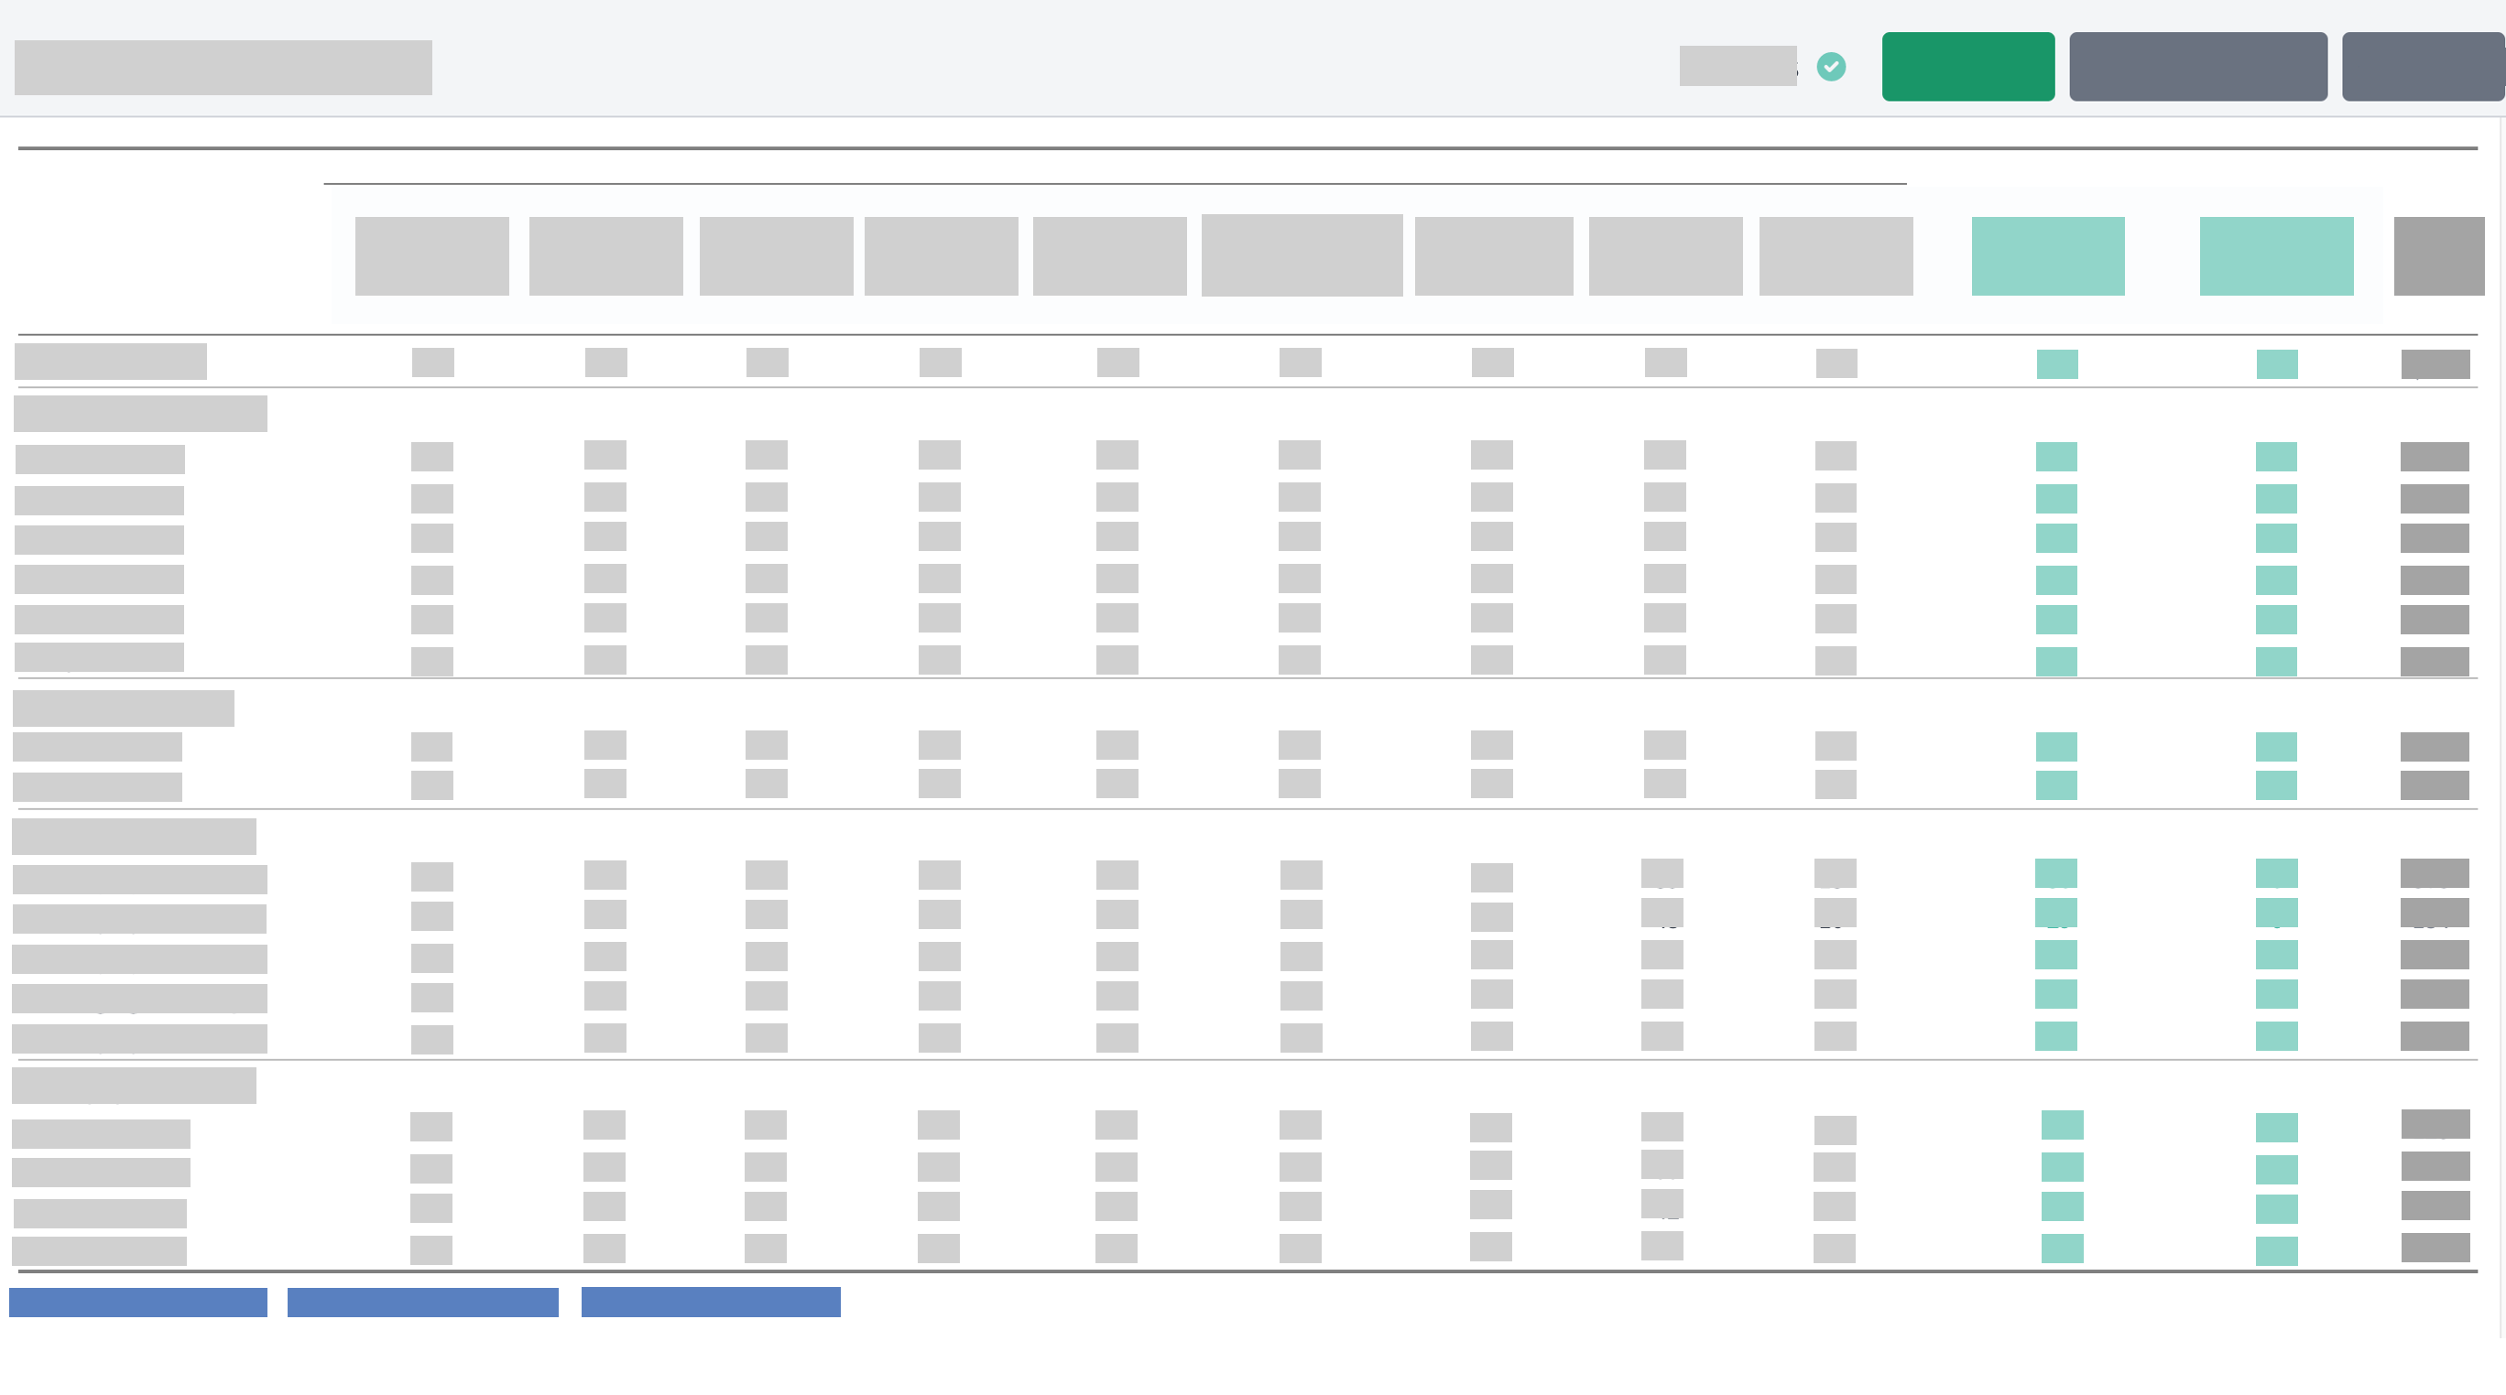
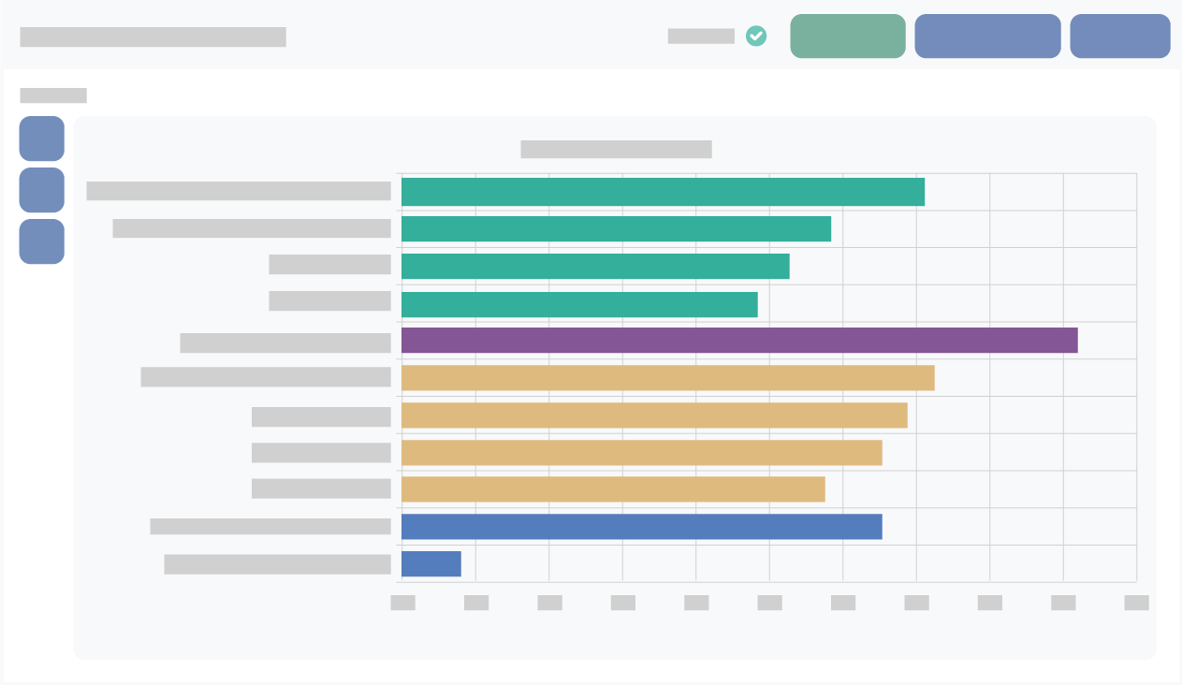
HHFA data visualization
Well-displayed data can:
facilitate the review and interpretation of the HHFA findings
tables
graphs
maps
help to communicate the findings in an effective way to users
complementary ways of visualizing data
Notes:
Well-displayed data can facilitate the review and interpretation of the HHFA findings. It can also help to communicate the findings in an effective way to users.
Tables, graphs and maps represent complementary ways of visualizing data.

Slide 11
Tables
It is often best to start with a table.
Tables:
can present the details of the data
allow the viewer to scrutinize the numbers directly
are useful for displaying many indicators at once
Colours can be used to highlight certain values in a table – “heatmap”.
Notes:
There are no rules about when to use a table, graph or map, but it is often best to start with a table, because tables have some advantages.
For example, tables:
can present the details of the data;
allow the viewer to scrutinize the numbers directly; and
are useful for displaying many indicators at once.
Sometimes colours are used to highlight certain values in a table. This is called a “heatmap” and is useful for identifying data patterns within a table.

Slide 12
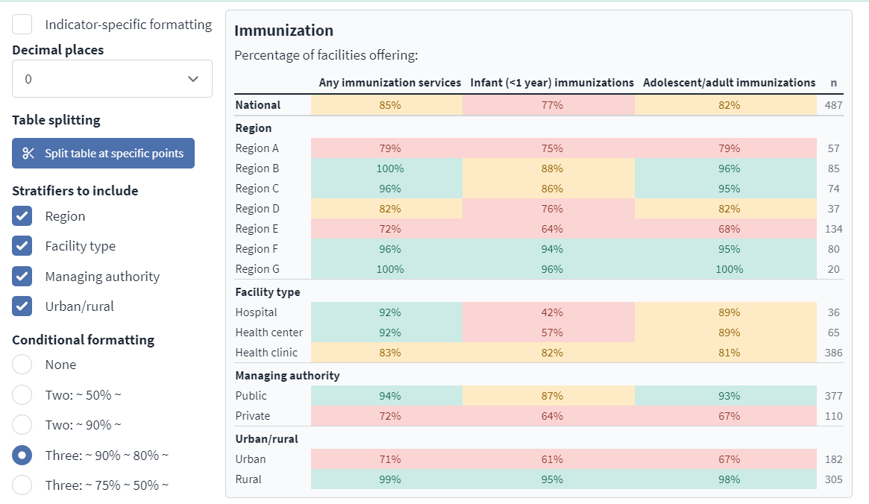
HHFA data analysis platform outputs - example “heatmap”
Notes:
This is an example of a table from the analysis platform where conditional formatting is used to create a “heatmap”.
Indicator frequencies from 90 to 100% are highlighted in green, while those from 80 to 89% are yellow, and those below 80% are pink.
The heatmap quickly shows that:
Regions A and E have the lowest performance for all three indicators;
a higher percentage of public facilities offer immunization services compared with private facilities; and
rural areas also perform better than urban areas for these indicators.
The screenshot also shows how users can select the stratifier variables they want to include in the table.

Slide 13
Graphs
Graphs are used to:
summarize data
attract the interest of viewers
display large, complex sets of data in a summarized way
enable easy comparison across categories
Notes:
Graphs are used to summarize data and often attract the interest of viewers.
Graphs are particularly useful for:
displaying large, complex sets of data in a summarized way; and
for enabling comparisons across categories.

Slide 14
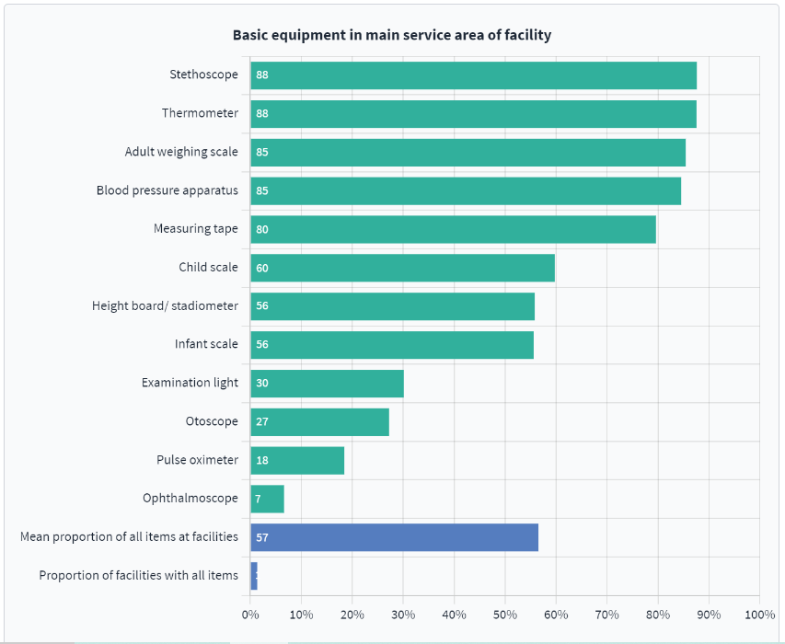
HHFA data analysis platform - example graph
Notes:
This bar graph from the analysis platform shows the percentage of facilities that have various basic equipment items in the main service area of the facility.
Whenever possible, the bars should be shown in ascending or descending order for easy visualization.
The two blue bars are indices that represent all the items in the table.

Slide 15
Maps
Maps provide an alternative way of displaying data that are geographically related.
Pros
Cons
visually appealing
can hide information
display administrative borders locations of health facilities
cannot provide all the details that tables offer
allow quick comparisons among geographic areas
Notes:
Maps provide an alternative way of displaying data that are geographically related.
Maps:
are visually appealing and are useful for attracting the attention of users;
they can display administrative borders and locations of health facilities;
they allow quick comparisons among geographic areas such as regions, by displaying the regions in different colours according to the values of the indicator.
However, it is important to remember that maps can also hide information, as they cannot provide all the details that tables offer.

Slide 16
Maps
Maps can complement, but not substitute for, tables and graphs.
Notes:
Maps can therefore complement, but not substitute for, tables and graphs.

Slide 17
You have now completed Unit 2.
Now try the end-of-module quiz.
Notes:
You have now completed Unit 2.
Now try the end-of-module quiz.

